Slide 1


Retail Sales Analysis
This presentation will explore Walmart's sales data to uncover actionable insights and guide strategic decisions. We'll delve into key metrics and analyze trends using SQL queries to extract and interpret relevant data
By Rahul Chatterjee
rahulchatterjee21@outlook.com

Slide 2
Introduction
Walmart, a retail giant, is a prominent player in the global market. Our analysis aims to extract valuable insights from Walmart's sales data to enhance business strategies, improve decision-making, and optimize operations.
1
Objectives
2
Goals
Analyze Walmart's sales data using SQL queries to answer 14 key business questions and derive insights for better decision-making.
Identify and understand the 14 questions from the "Reference File for Walmart sales data."
Write SQL queries to accurately extract and analyze data.
Present the findings in a PowerPoint presentation with a clear structure

Slide 3
Dataset Overview
• Invoice_ID: Unique identifier for each invoice.
• Branch: Branch of the store where the sale took place.
• City: City where the store branch is located.
• Customer_type: Type of customer (e.g., Member, Normal).
• Gender: Gender of the customer.
• Product_line: Category of the product sold.
• Unit_price: Price per unit of the product.
• Quantity: Quantity of the product sold.
• Tax_5%: Tax applied on the sale.
• Total: Total amount of the sale.
• Date: Date of the transaction.
• Time: Time of the transaction.
• Payment: Payment method used (e.g., Cash, Credit Card).
• cogs: Cost of goods sold.
• gross_margin_percentage: Gross margin percentage.
• gross_income: Gross income from the sale.
• Rating: Customer rating for the purchase.

Slide 4
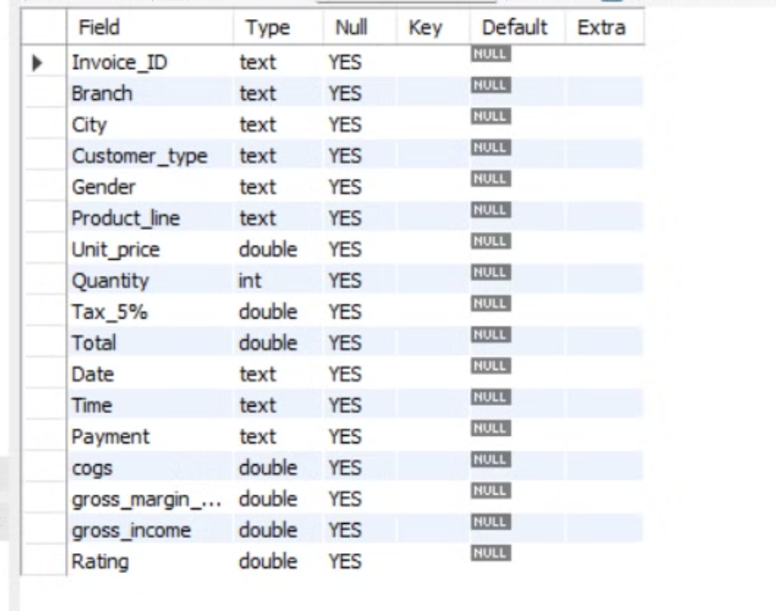
Structure of the table

Slide 5
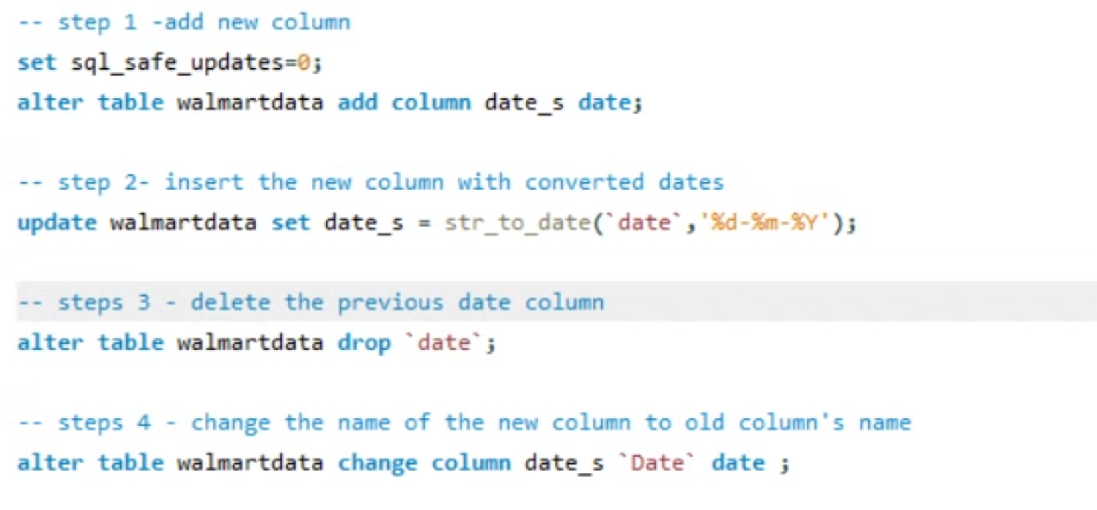
Schema modification

Slide 6
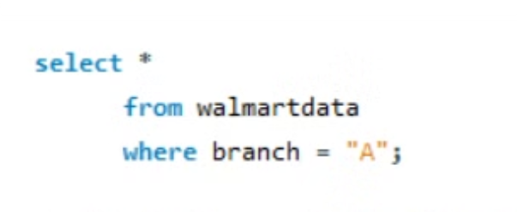
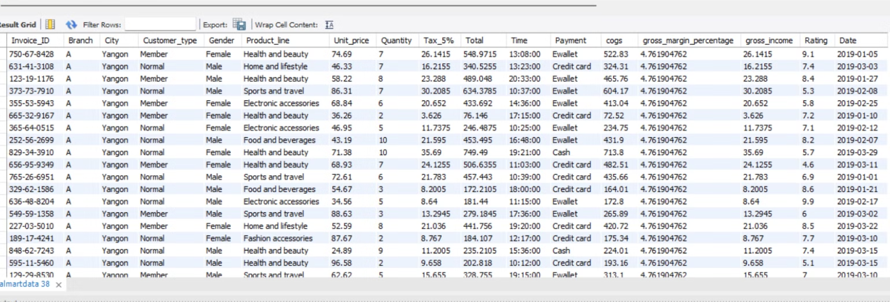
Qs1- Retrieve all columns for sales made in a specific branch (e.g., Branch 'A').

Slide 7
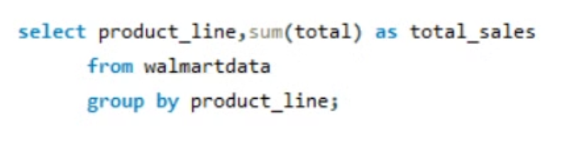
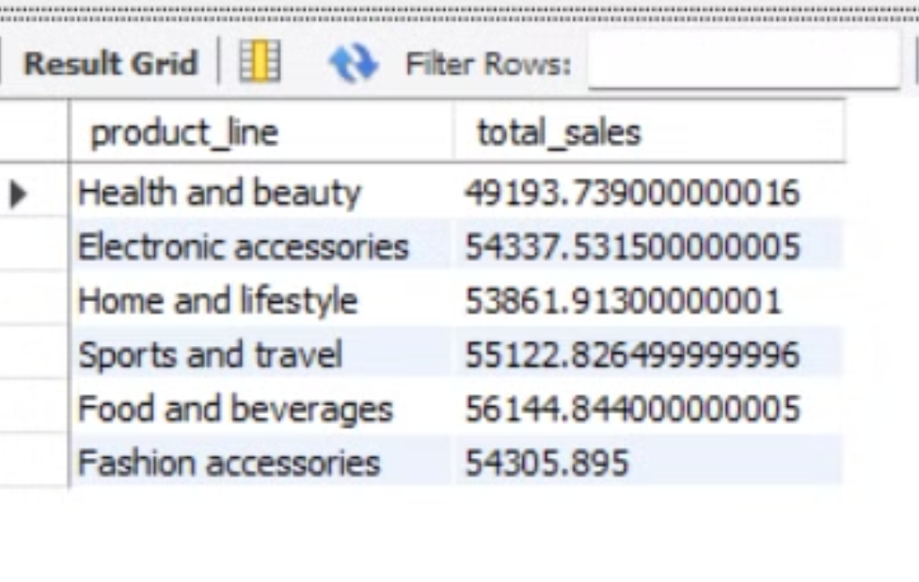
Qs2-Find the total sales for each product line.

Slide 8
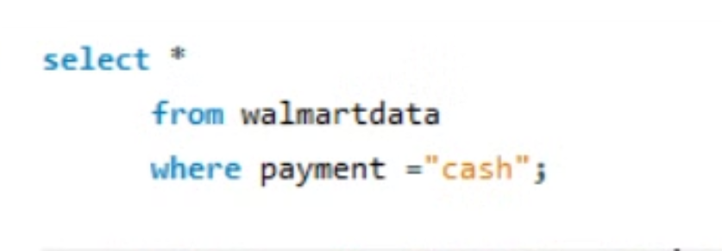
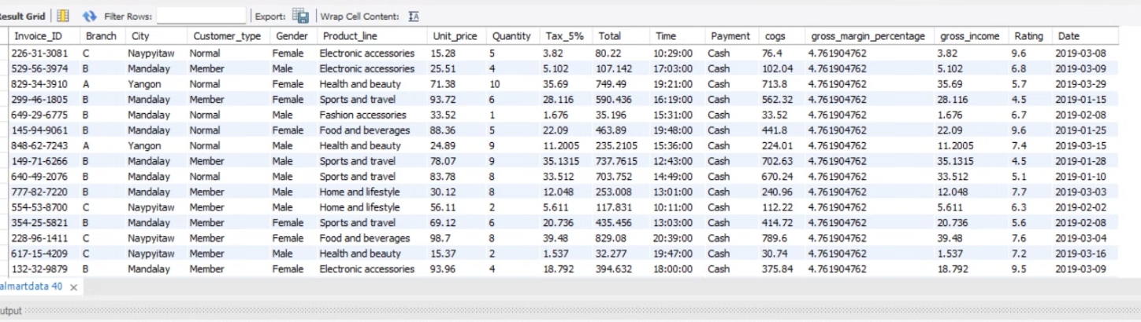
Qs3-List all sales transactions where the payment method was 'Cash'.

Slide 9
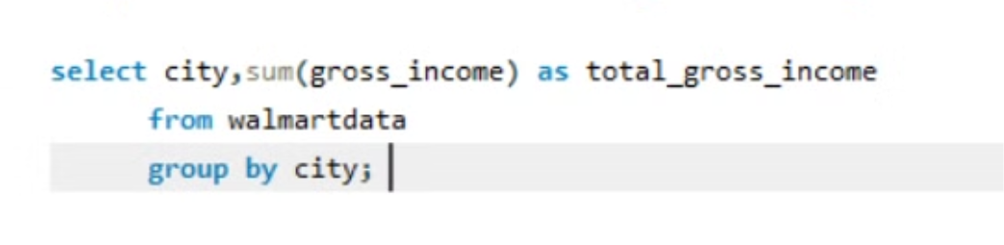
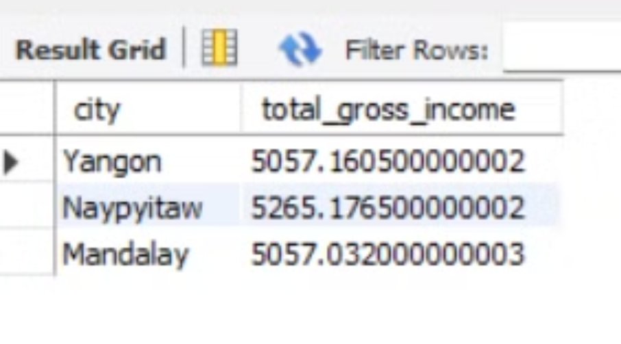
QS4-Calculate the total gross income generated in each city.

Slide 10
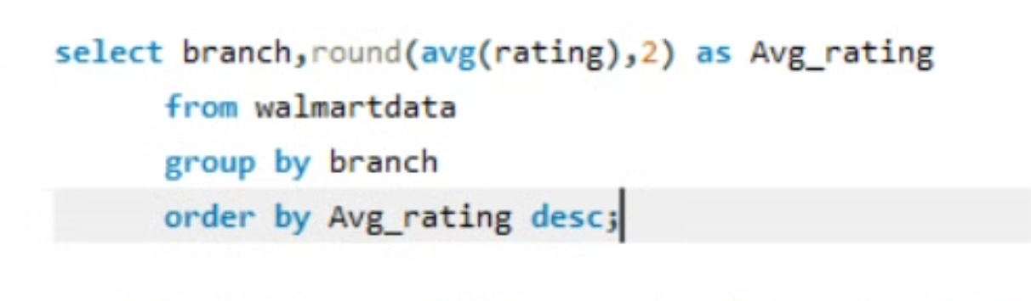
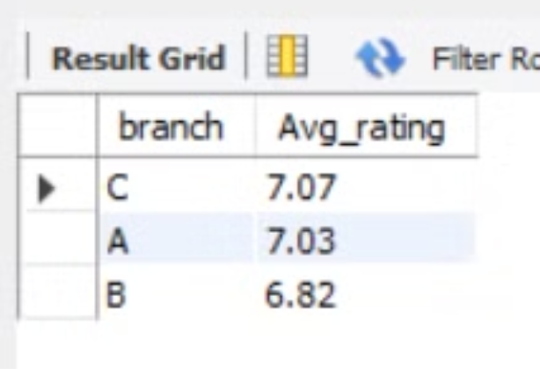
QS5-Find the average rating given by customers in each branch.

Slide 11
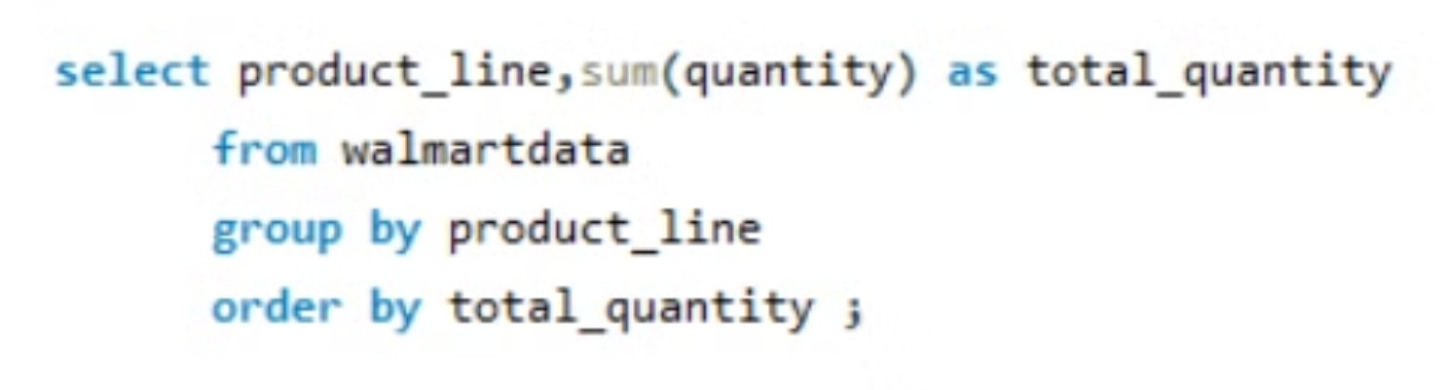
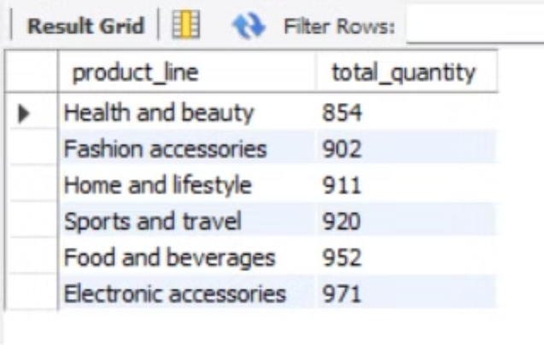
QS6-Determine the total quantity of each product line sold.

Slide 12
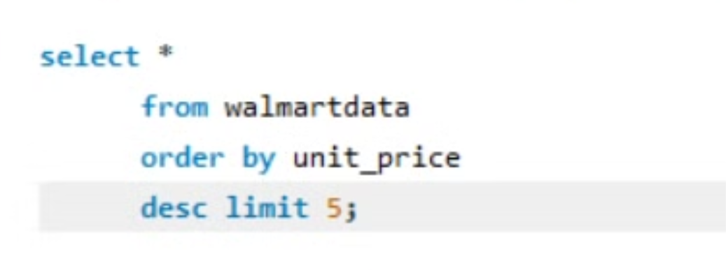
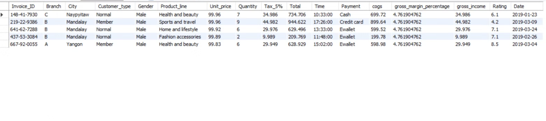
QS 7-List the top 5 products by unit price.

Slide 13
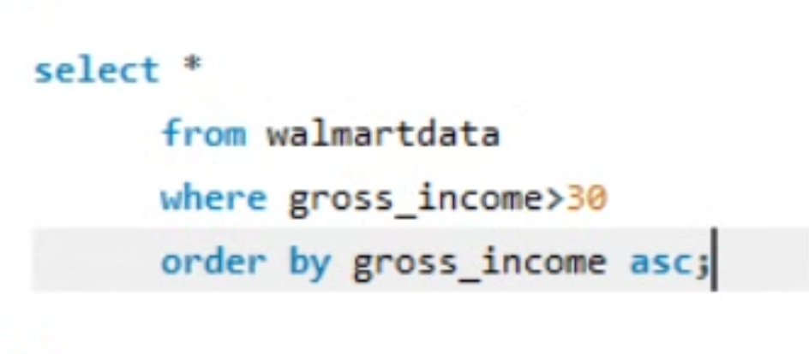
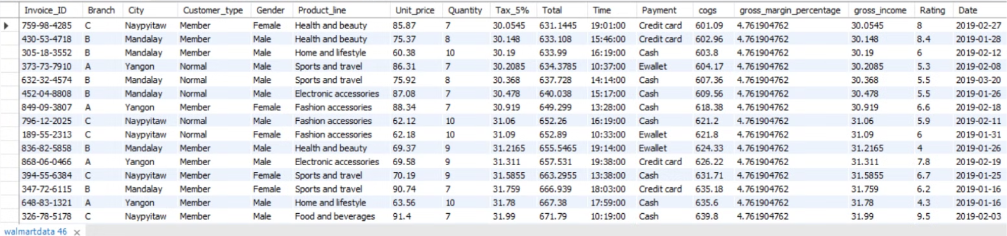
QS 8-Find sales transactions with a gross income greater than 30.

Slide 14
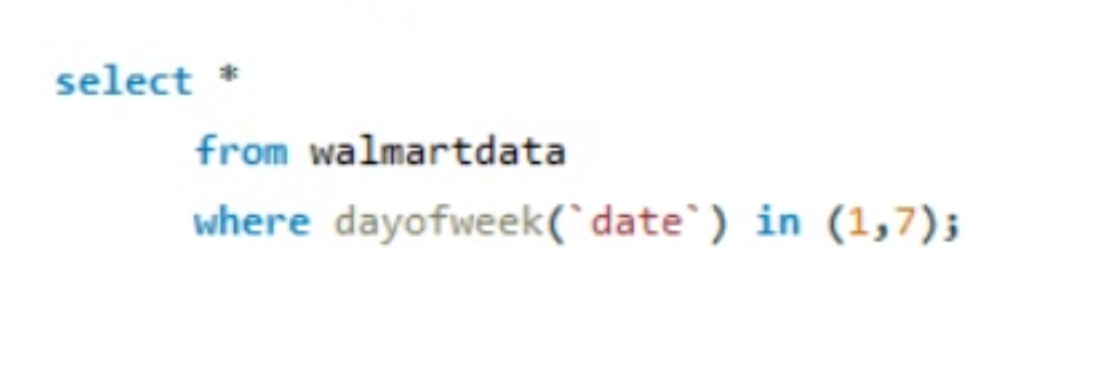
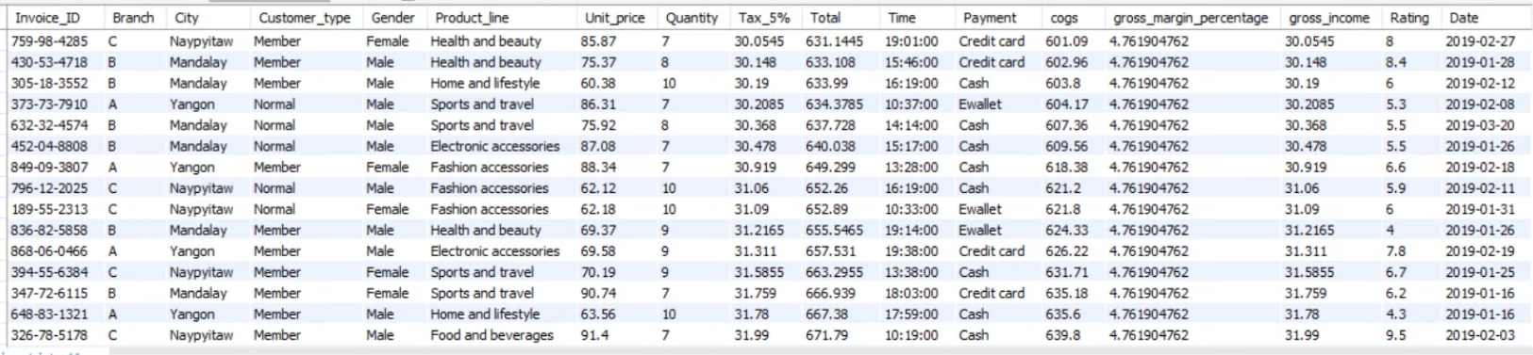
QS 9-Retrieve sales transactions that occurred on weekends.

Slide 15
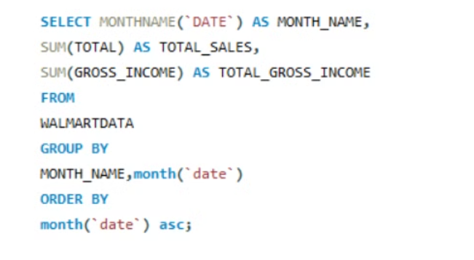
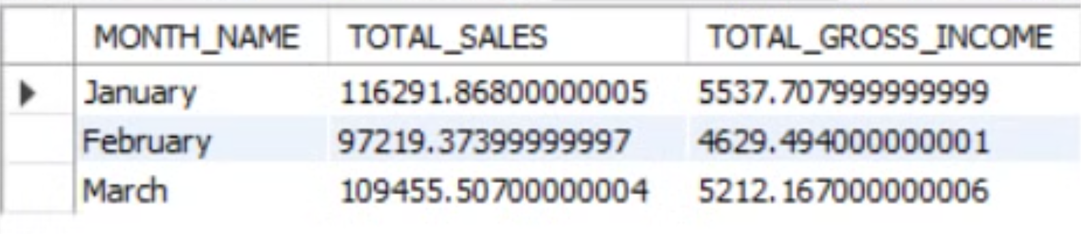
QS 10-Calculate the total sales and gross income for each month.

Slide 16
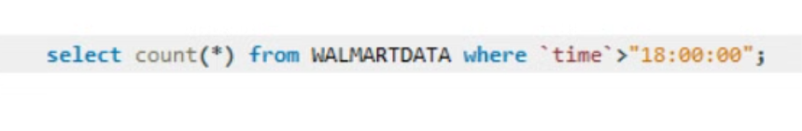
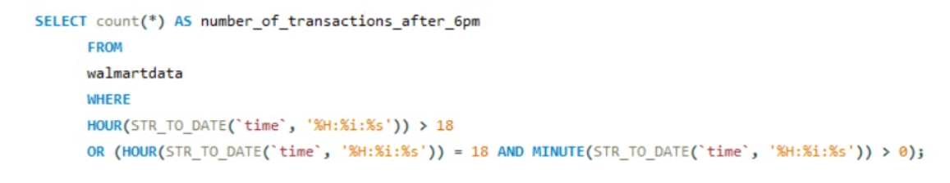
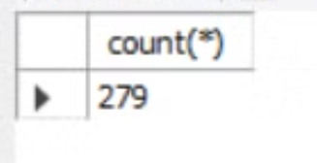
QS 11-Find the number of sales transactions that occurred after 6 PM.

Slide 17
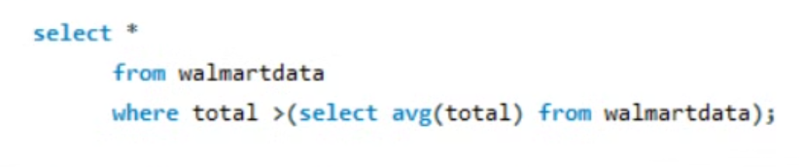
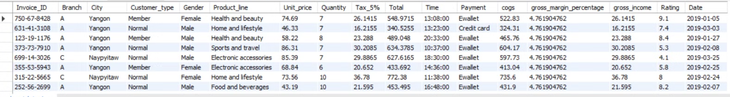
QS 12-List the sales transactions that have a higher total than the average total of all transactions.

Slide 18
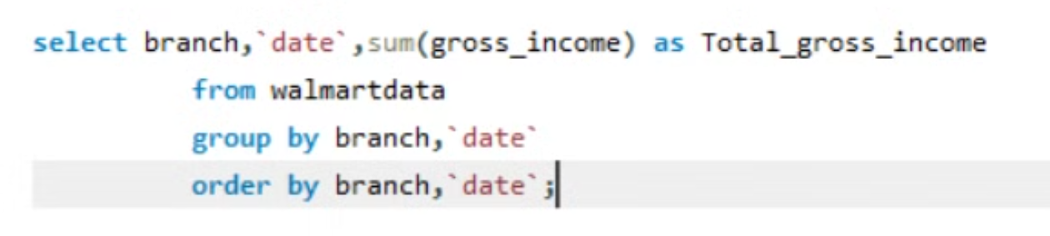
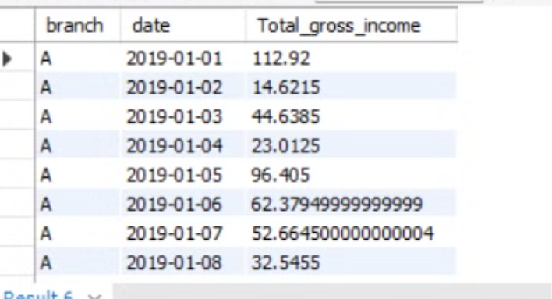
QS 13-Calculate the cumulative gross income for each branch by date

Slide 19
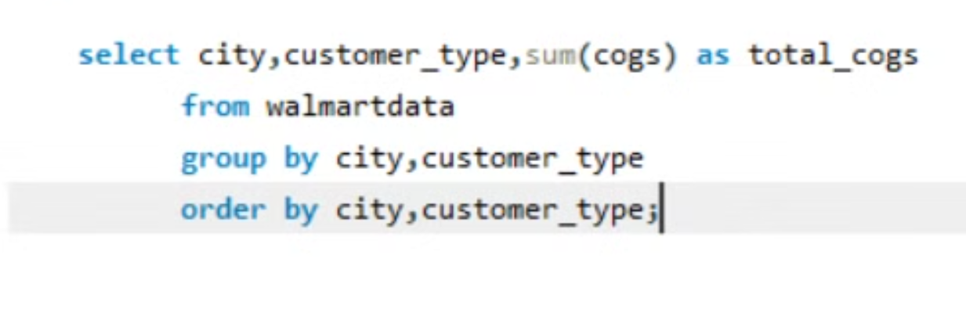
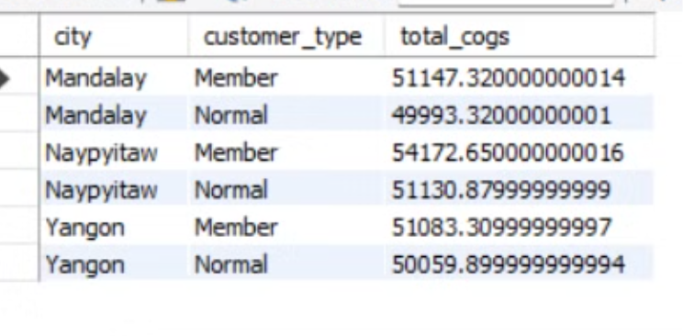
QS 14-Find the total cogs for each customer type in each city.

Slide 20


